Slide 1
JAVA SERVER PAGE
SESSION
COOKIES

Slide 2
NỘI DUNG
Session
Cookies
URL Writing
Hidden Form Fields
Mở rộng trang JSP

Slide 3
SESSION – KHÁI NIỆM
HTTP là một stateless protocol.
Session tracking là cơ chế để hỗ trợ việc lưu trữ thông tin trạng thái qua các thành phần của Servlet API.
Session là cách giải quyết việc lưu trữ thông tin – trạng thái trong Web application.
Session hỗ trợ Web Server phân biệt các users khác nhau.
Session được thiết kế như thành phần của Server giải quyết stateless theo 03 cách
  Cookies
  URL – Writing
  Hidden form fields
Session được khởi tạo khi user truy cập hay login vào trang Web.
Thời gian tồn tại của Session:
  Đóng Web browser.
  Logout khỏi ứng dụng Web.
  Time out.

Slide 4
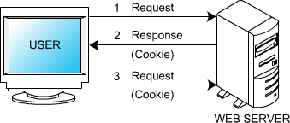
COOKIES
Cookies là các thông tin text đơn giản để Web server gửi tới browser. Các request trong lần tiếp theo sẽ đính kèm cookies.
Server dùng cookies để sử dụng các thông tin của clients.
Mỗi browser có thể chứa 20 cookies/ site và tối đa là 300 cookies.
Kích thước tối đa của cookies là 4Kb
Mỗi Cookies có 01 SessionID tương ứng.
Ưu điểm
  Xác nhận user trong suốt quá trình giao dịch điện tử
  Hỗ trợ việc checkLogin (low security)
  Hỗ trợ việc cung cấp thông tin ưa thích cho người dùng
  Hỗ trợ cho việc quảng cáo trên trang web
  Có tính bảo mật
Nhược điểm
  Xâm phạm tự do riêng tư
  Gây ra các spam về mail và trang web.
  Browser phải hỗ trợ hay cho phép cookies.
  Kích thước giới hạn.

Slide 5
SERVLET COOKIES
Tạo cookies bằng cách gọi Cookies constructor
Các phương thức API hỗ trợ
  get/setVersion (chuỗi): version của protocol Cookies
  int get/setMaxAge(int):thời gian cookies expires (s)
  String get/setName(tên cookies)
  String get/setPath(String path): đường dẫn chứa cookies. “/” tất cả trang
  String get/setValue(String):các giá trị kết hợp với cookies
  response.addCookies: insert cookies
  request.getCookies: đọc cookies từ client

Slide 6
VÍ DỤ
Lưu cookies trên máy và hiển thị thông tin
<%@ page import="javax.servlet.http.Cookie" %>
<html>
<head> <title>Cookies Demo</title> </head>
<body>
<h1>Cookies</h1>
<% Cookie[] allCookies = request.getCookies();
Cookie ourCookie=null;
if(allCookies!=null){
for(int i=0; i<allCookies.length; i++) {
if(allCookies[i].getName().equals("TestCookies")) {
ourCookie = allCookies[i]; }}}
if(ourCookie==null){
Cookie cookie=new Cookie("TestCookies", "welcome Cookie");
cookie.setPath("/");
response.addCookie(cookie);%>
A cookie has beean added to your machine!
<br>Select refresh to see the details of the cookie.
<% } else {%>
The following cookie was added earlier to your machine:
<br>Version: <%= ourCookie.getVersion() %>
<br>Name: <%= ourCookie.getName() %>
<br>Value: <%= ourCookie.getValue() %>
<br>MaxAge: <%= ourCookie.getMaxAge() %>
<% } %> </body>
</html>

Slide 7
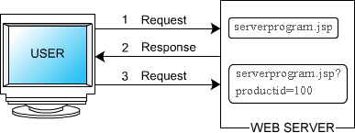
URL WRITING
Đưa dữ liệu bổ sung vào phần cuối của URL để server có thể đọc thông tin về session.
Ví dụ: http://host/path.file.html?jsessionid=12345
Ưu điểm: Browser không cần hỗ trợ cookies.
Nhược điểm:
  Server mất nhiều thời gian để xử lý
  Thông tin session có thể bị mất khi user rời session.

Slide 8
VÍ DỤ
index.jsp
<form action="URLProgram.jsp" method="post">
User name: <input type="text" name="name"><br>
Password: <input type="password" name="pwd"><br>
<input type="submit" value="Login">
</form>
URLProgram.jsp
<% String name=request.getParameter("name");
String password=request.getParameter("pwd");
if(name.equals("Aptech") && password.equals("123456")){
session.setAttribute("username", name);
String string=response.encodeURL("NextPage.jsp?name=" + name + "&password=" + password);%>
Click here forward to <a href="<%= string %>">Welcome</a>
<% }else{
String string=response.encodeURL("index.jsp?name=" + name + "&password=" + password); %>
Please enter your information. Click <a href="<%= string %>">here</a> to go back.
<% }%>
NextPage.jsp
Hello <%= session.getAttribute("username") %>

Slide 9
HIDDEN FORM FIELDS
Dùng field ẩn để lưu trữ thông tin session
<INPUT TYPE=“HIDDEN” NAME=“session” VALUE=“<giá trị>”>
Nhược điểm:
  Chỉ làm việc trên các trang phát sinh động
  Lấy thông tin qua View source của Browser

Slide 10
VÍ DỤ
index.jsp
<form action="getHidden.jsp" method="post">
User Name: <input type="name" name="name"><br>
<input type="hidden" name="hidden" value="You are welcome">
<input type="submit" value="submit">
</form>
getHidden.jsp
<% out.println(request.getParameter("name")); %>
The hidden text is: <% out.println(request.getParameter("hidden")); %>

Slide 11
SESSION TRACKING in SERVLETS
Servlet cung cấp một nơi để lưu trữ các thông tin cần thiết về session.
Session Tracking:
  Xác định đối tượng HttpSession có liên quan đến request hiện hành:
    Sử dụng phương thức getSession của HttpServletRequest
    Hệ thống thực hiện trích xuất userID từ cookie hay dữ liệu attach trong URL để tạo ra đối tương HttpSession
    Xác định xem user đã tồn tại hay chưa? Nếu chưa tồn tại thì thực hiện tạo mới dùng phương thức getSession(true).
    HttpSession tồn tại trên server và cho phép lưu trữ key và các giá trị
    Ví dụ: HttpSession session = request.getSession(true);

Slide 12
SESSION TRACKING in SERVLETS (tt)
Session Tracking (tt)
  Tìm kiếm và thiết lập các thông tin trong Session
    Sử dụng phương thức (Object) session.getValue(“tên thuộc tính”) (2.1) hay session.getAttribute(“tên thuộc tính”) (2.2) để lấy giá trị của thuộc tính lưu trữ.
    Sử dụng phương thức (String[]) session.getValueNames() hay session.getAttributeNames() để lấy tất cả tên thuộc tính có trong Session
    Các phương thức hỗ trợ khác
      setAttribute – putValue(“tên thuộc tính”, giá trị)
      removeAttribute – removeValue(“tên thuộc tính”)
      String getId()
      boolean isNew(): false nếu tồn tại Session
      long getCreateTime() hay long getLastAccessedTime()
      int getMaxInactiveInterval() và setMaxInactiveInterval(int seconds)

Slide 13
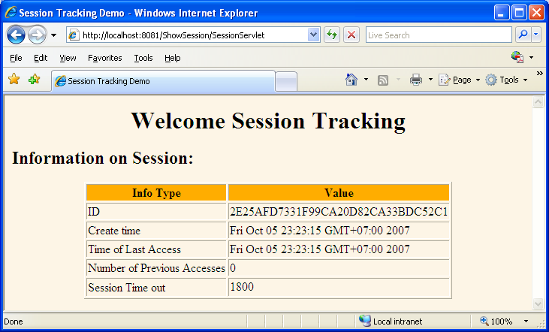
VÍ DỤ
In các thông tin về Session

Slide 14
VÍ DỤ (tt)
Servlet
public void doGet(HttpServletRequest request, HttpServletResponse response) throws IOException, ServletException{
response.setContentType("text/html");
PrintWriter out=response.getWriter();
String title="Session Tracking Demo";
HttpSession session=request.getSession(true);
String heading;
Integer accessCount = (Integer)session.getAttribute("accessCount");
if(accessCount==null){
accessCount=new Integer(0);
heading="Welcome Session Tracking";}
else{
heading="Comeback";
accessCount=new Integer(accessCount.intValue() + 1);}
session.setAttribute("accessCount", accessCount);
out.println("<HTML><HEAD><TITLE>" + title + "</TITLE></HEAD>\n" + "<BODY BGCOLOR=\"#FDF5E6\">\n" +
"<H1 ALIGN=\"CENTER\">" + heading + "</H1>\n<H2>Information on Session:</H2>\n" +
"<TABLE BORDER=1 ALIGN=\"CENTER\">\n<TR BGCOLOR=\"#FFAD00\">\n <TH>Info Type<TH>Value\n" +
"<TR>\n <TD>ID\n <TD>" + session.getId() + "\n<TR>\n <TD>Create time\n <TD>" +
new Date(session.getCreationTime()) + "\n<TR>\n <TD>Time of Last Access\n <TD>" +
new Date(session.getLastAccessedTime()) + "\n<TR>\n <TD>Number of Previous Accesses\n <TD>" +
accessCount + "\n<TR>\n <TD>Session Time out\n <TD>" + session.getMaxInactiveInterval() +
"<TABLE>\n</BODY></HTML>");}

Slide 15
VÍ DỤ (tt)
JSP (nút lệnh submit gọi Servlet)
web.xml
<display-name>Show Session</display-name>
<servlet>
<servlet-name>Session</servlet-name>
<display-name>SessionServlet</display-name>
<servlet-class>JSession.ShowSess</servlet-class>
</servlet>
<servlet-mapping>
<servlet-name>Session</servlet-name>
<url-pattern>/SessionServlet</url-pattern>
</servlet-mapping>
<welcome-file-list>
<welcome-file>SSession.jsp</welcome-file>
</welcome-file-list>

Slide 16
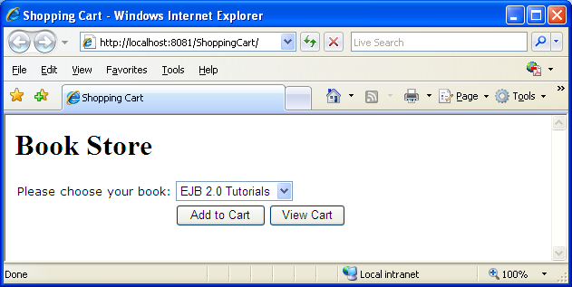
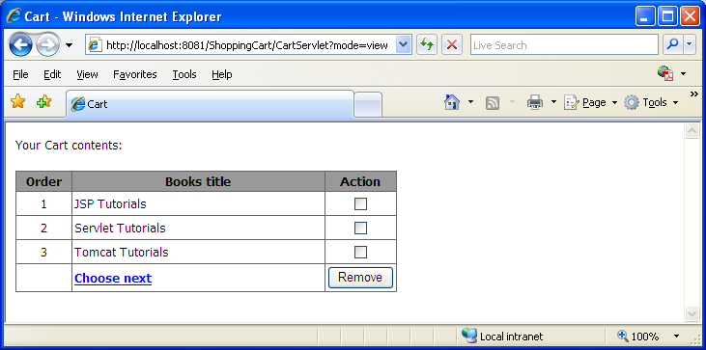
VÍ DỤ
Thực hiện về Shopping Cart

Slide 17
VÍ DỤ (tt)
JSP
<html> <head><title>Shopping Cart</title>
<script language="javascript">
function doAction(t){
if(t.value=="Add to Cart") document.frm.action='/ShoppingCart/CartServlet?mode=add';
if(t.value=="View Cart") document.frm.action='/ShoppingCart/CartServlet?mode=view';
document.frm.submit();}
</script>
</head>
<body>
<h1>Book Store</h1>
<form method="post" name="frm">
<table border="0" celpadding="0" celspacing="0" width="450">
<tr> <td width="180"><font face="Verdana" size="2">Please choose your book:</font></td>
<td width="280">
<select name="lstBook" size="1">
<option>EJB 2.0 Tutorials</option>
...
</select> </td> </tr>
<tr> <td>&nbsp</td>
<td> <input value="Add to Cart" onclick="doAction(this)" type="button">
<input value="View Cart" onclick="doAction(this)" type="button"> </td> </tr>
</table>
</form>
</body>
</html>

Slide 18
VÍ DỤ (tt)
Java class
private String customerName;
private String customerId;
private Vector contents;
public CartBean()
{ khởi tại giá trị cho các thuộc tính}
Thực hiện các get/ set cho customerName, getContents
public void addBook(String title){
contents.addElement(title);}
public void removeBook(String title)throws Exception{
boolean result=contents.removeElement(title);
if(result==false){
throw new Exception(title + " not found");}}

Slide 19
VÍ DỤ (tt)
Servlet
resp.setContentType("text/html");
PrintWriter pw=resp.getWriter();
pw.println("<html><head><title>Cart</title></head><body>");
HttpSession session=req.getSession(true);
CartBean shoppingCart=(CartBean)session.getAttribute("cart");
if(shoppingCart==null){ shoppingCart=new CartBean();}
String action=req.getParameter("mode");
String bookTitle=req.getParameter("lstBook");
if(action.equals("add")){
shoppingCart.addBook(bookTitle);
RequestDispatcher rd=getServletContext().getRequestDispatcher("/");
rd.forward(req, resp);}
if(action.equals("view")){
int count=0; String booktitle;
pw.println("<font face='Tahoma' size='2'>Your Cart contents:</font><br>");
Vector bookList=shoppingCart.getContents();
Enumeration item=bookList.elements();
pw.println("<form action='CartServlet?mode=remove' method='post'>");
pw.println( "<table border='1' cellpadding='2' cellspacing='0' width='395' " );
pw.println( "bordercolor='#666666' style='border-collapse: collapse'><tr>" );
pw.println( "<td bgcolor='#999999' width='53' align='center'>" );
pw.println( "<b><font face='Tahoma' size='2'>Order</font></b></td>" );
pw.println( "<td bgcolor='#999999' width='257' align='center'><b>" );
pw.println( "<font face='Tahoma' size='2'>Books title</font></b></td>" );
pw.println( "<td bgcolor='#999999' align='center'>" );
pw.println( "<b><font face='Tahoma' size='2'>Action</font></b></td>" );
pw.println( "</tr>" );

Slide 20
VÍ DỤ (tt)
Servlet (tt)
while(item.hasMoreElements()){
++count;
booktitle=(String)item.nextElement();
pw.println( "<tr><td align='center'><font face='Tahoma' size='2'>" + count + "</font></td>" );
pw.println( "<td><font face='Tahoma' size='2'>" + booktitle + "</font></td>");
pw.println( "<td align='center' valign='middle'>" );
pw.println( "<input type='checkbox' name='rmv' value='" + booktitle + "'></td></tr>" );}
pw.println( "<tr><td></td><td>" );
pw.println( "<font face='Tahoma' size='2'><a href='/ShoppingCart/index.html'><b>Choose next</b></a></font>" );
pw.println( "</td><td><input type='submit' value='Remove'></td></tr></table></form>" );}
if(action.equals("remove")){
String title[]=req.getParameterValues("rmv");
if(title==null){ title=new String[0];}
try{ for(int i=0; i<title.length; i++) {
shoppingCart.removeBook(title[i]);}}catch(Exception e){}
RequestDispatcher rd=getServletContext().getRequestDispatcher("/CartServlet?mode=view");
rd.forward(req, resp);}
session.setAttribute("cart", shoppingCart);
pw.println("</body></html>");
pw.close();

Slide 21
VÍ DỤ (tt)
web.xml
<web-app>
<display-name>Cart</display-name>
<welcome-file-list>
<welcome-file>index.html</welcome-file>
</welcome-file-list>
<servlet>
<servlet-name>CartServlet</servlet-name>
<servlet-class>SJSP.CartServlet</servlet-class>
</servlet>
<servlet-mapping>
<servlet-name>CartServlet</servlet-name>
<url-pattern>/CartServlet</url-pattern>
</servlet-mapping>
</web-app>

Slide 22
SUPER – SUB CLASS
Hỗ trợ các phương thức sử dụng nhiều lần thành phương thức sẵn có như ngôn ngữ lập trình JSP.
Super Class: Mở rộng các thành phần chuẩn của trang JSP hỗ trợ cho lập trình.
Các bước vận dụng Super Class
  Dẫn xuất (extends) của javax.servlet.HttpServlet và implements javax.servlet.jsp.HttpJspPage
  Lớp khai báo public
  Tất cả phương thức chuẩn của Servlet interface phải được khai báo là final public
  Phương thức service() phải gọi phương thức _jspService(req, res)
  Phương thức _jspService phải được khai báo abstract public
  Phương thức init phải gọi phương thức jspInit()
  Phương thức destroy phải gọi phương thức jspDestroy()
  Các phương thức bổ sung phải được khai báo là public

Slide 23
SUPER – SUB CLASS
Sub Class: sử dụng các phương thức cài đặt trong super class
Các bước tạo Sub Class
  Khai báo page directive với cú pháp
  <%@ page extends = “tên superclass” %>
  Implements phương thức jspInit() và jspDestroy()
  Gọi các phương thức implements trong Super Class
Ví dụ:
  Thực hiện super class có 03 phương thức lấy user, lấy catalog và in ra thông tin của Servlet
  Thực hiện gọi ba phương thức thực hiện trong Sub Class

Slide 24
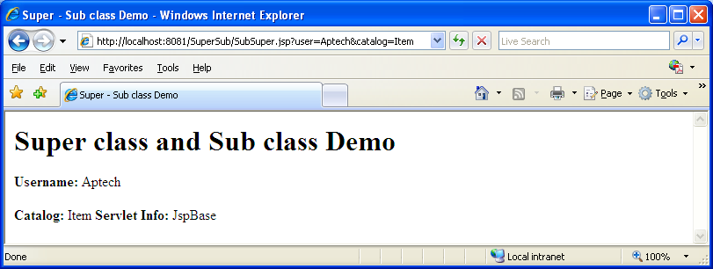
VÍ DỤ (tt)

Slide 25
VÍ DỤ (tt)
Super Class
package JSupSub;
import javax.servlet.*;
import javax.servlet.http.*;
import javax.servlet.jsp.HttpJspPage;
import java.io.*;
import java.util.*;
public abstract class JSPBase extends HttpServlet implements HttpJspPage{
private ServletConfig config;
final public void init(ServletConfig config)throws ServletException{
this.config=config; jspInit();}
final public ServletConfig getServletConfig(){return config;}
final public void service(HttpServletRequest request, HttpServletResponse response) throws ServletException, IOException{ jspService(request, response);}
abstract public void _jspService(HttpServletRequest request, HttpServletResponse response)throws ServletException, IOException;
final public void destroy(){jspDestroy();}
final public void init(){jspInit();}
public String getUser(HttpServletRequest request){return (String)request.getParameter("user");}
public String getCatalog(HttpServletRequest request){
return (String)request.getParameter("catalog");}
public String getServletInfo(){ return new String("JspBase");}
}

Slide 26
VÍ DỤ (tt)
Sub Class
<%@ page extends="JSupSub.JSPBase" %>
<html>
<head> <title>Super - Sub class Demo</title> </head>
<body>
<h1>Super class and Sub class Demo</h1>
<%!
public void jspInit(){
System.out.println("init");}
public void jspDestroy(){
System.out.println("Destroy");} %>
<% out.println("<B>Username: </B>" + getUser(request) + "<P></P>");
out.println("<B>Catalog: </B>" + getCatalog(request));
out.println("<B>Servlet Info: </B>" + getServletInfo()); %>
</body>
</html>

Slide 27
VÍ DỤ (tt)
web.xml
<?xml version="1.0"?>
<!DOCTYPE web-app PUBLIC "-//Sun Microsystems, Inc.//DTD Web Application 2.3//EN" "http://java.sun.com/dtd/web-app_2_3.dtd">
<web-app>
<display-name>SubSub</display-name>
<welcome-file-list>
<welcome-file>SubSuper.jsp</welcome-file>
</welcome-file-list>
<servlet>
<servlet-name>JSPBase</servlet-name>
<servlet-class>SJSP.JSPBase</servlet-class>
</servlet>
<servlet-mapping>
<servlet-name>JSPBase</servlet-name>
<url-pattern>/JSPBase</url-pattern>
</servlet-mapping>
</web-app>

Slide 28
Bài tập
Thực hiện lại các bài tập demo
Xây dựng login hỗ trợ cookies

